Slide 1

How to draw a graph by gnuplot
Yigong Hu
05/25/2018
Notes:
Hi all, today I would like to ...

Slide 2

Graph for conference
Graph can delivery ideas more clearly than words
^{Two types of graphs}
  system design and workflow diagram
  ^{Evaluation graph}
^{A lot of drawing tools}
  ^{visio}
  ^{gnuplot}
  ^{pyplot}
How to draw an evaluation graph?
Notes:
Welcome
As we all known, in the respective of explaining idea, graphs are inherent better that words. Graphs are visualized and thus more intuitive and easy to understand than a verbose paragraph. Therefore, it is necessary to know how to draw a graph in a paper.
In computer system field, there are two commonly used types of graphs: workflow diagram and evaluation graph. A system design and workflow diagram provides a graphic overview of the system design and processing logic. Using standardized symbols and shapes, the workflow shows step by step how the system works from start to finish. The evaluation graph shows the evaluation result of your system.
There are a lot of drawing tool. For system design diagram, you can use draw.io, visio and so on. For evaluation graph, you have the gnuplot, excel, python plot, etc.
Today I would like to talk about how to draw an evaluation graph by using one of the popular tool, gnuplot.

Slide 3
Outline
^{Introduce gnuplot}
One example: drawing an boxplot
Drawing any type of basic graph
Notes:
In the following section, I will first introduce gnuplot and tell you the workflow of drawing a graph by using gnuplot. Then I will use one example to tell you all the common commands in gnuplot. Finally, I will show you how to draw any kinds of basic style by leveraging the code templates library of gnuplot.

Slide 4
Introduction of gnuplot
^{What is gnuplot?}
  ^{A graphing utility}
  ^{portable for many platforms}
  ^{2D and 3D}
  Supports many types of input and output
Notes:
Gnuplot is a portable command-line driven graphing utility for Linux, OS/2, MS Windows, OSX, VMS,and many other platforms. It was originally created to allow scientists and students to visualize mathematical functions and data interactively but has grown to support many non-interactive uses. Gnuplot has been supported and under active development since 1986.
Gnuplot supports many types of plots in either 2D and 3D. It can draw using lines, points, boxes, contours, vector fields, surfaces, and various associated text. It also supports various specialized plot types.
Gnuplot supports many different types of output: interactive screen terminals (with mouse and hotkey input), direct output to pen plotters or modern printers, and output to many file formats (eps, emf, fig, jpeg, LaTeX, pdf, png, postscript, ...)
Show gnuplot

Slide 5
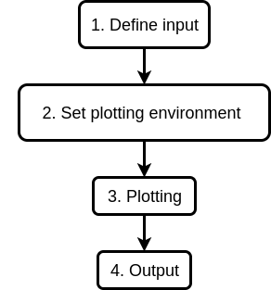
The workflow
The workflow of drawing a graph in gnuplot
Notes:
Talk about the workflow: 1. know the type of input
The types of input
Function
Data
Data format
2. set the plotting environment
Plotting environment
The types of plotting
The label, title, color, width
The position of label, title
11 common used commands
3. plotting
What does plotting do?
Change the layout of plots
Define the format of input
4. set the output
Define the format of output

Slide 6
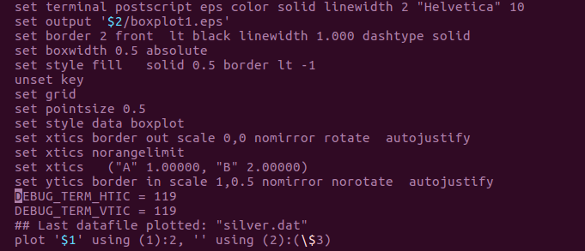
One example
The code snippet of drawing a boxplot
Set the output
Define the environment
plotting
Notes:
Explain the workflow by the code snippet

Slide 7
Set the environment
Command 1: set style data boxplot
  The set style data command changes the default plotting style for data plots.
Syntax:
set style data <plotting-style>
show style data

Slide 8
Set the environment
Command 2: set style fill solid 0.50 border lt -1
  The set style fill command is used to set the default style of the plot elements in plots
Syntax:
set style fill {empty
| {transparent} solid {<density>}
| {transparent} pattern {<n>}}
{border {lt} {lc <colorspec>} | noborder}

Slide 9
Set the environment
Command 3: set boxwidth 0.5 absolute
  The set boxwidth command is used to set the default width of boxes
Syntax:
set boxwidth {<width>} {absolute|relative}
show boxwidth

Slide 10
Set the environment
Command 4: set border 2 front lt black linewidth 1.000 dashtype solid
  The set border and unset border commands control the display of the graph borders
Syntax:
set border {<integer>}
{front | back | behind}
{linestyle | ls <line_style>}
{linetype | lt <line_type>} {linewidth | lw <line_width>}
{linecolor | lc <colorspec>} {dashtype | dt <dashtype>}
{polar}
unset border
show border
Linetypes, colors, and styles
  test command

Slide 11
Set the environment
Command 5: set grid
Command 6: set xlabel
The set xlabel command sets the x axis label. Similar commands set labels on the other axes.
Syntax:
set xlabel {"<label>"} {offset <offset>} {font "<font>{,<size>}"}
{textcolor <colorspec>} {{no}enhanced}
{rotate by <degrees> | rotate parallel | norotate}
show xlabel

Slide 12
Set the environment
Command 7: set xtics
  Fine control of the major (labeled) tics on the x axis is possible with the set xtics command. The tics may be turned off with the unset xtics command
Syntax:
set xtics {axis | border} {{no}mirror}
{in | out} {scale {default | <major> {,<minor>}}}
{{no}rotate {by <ang>}} {offset <offset> | nooffset}
{left | right | center | autojustify}
{add}
{ rangelimited }
unset xtics
show xtics

Slide 13
Set the environment
Command 8:set title
Command 9: set key
Command 10: set Xrange

Slide 14
Plotting
Plotting and using

Slide 15
Output
Set Terminal
Set output

